Slide 1




Slide 2

Kruskal's Algorithm

Slide 3

TEST TIME ON HAMILTONIAN CYCLE
URL:https://forms.gle/gh43AnHbnZjrFVgu8
QR CODE:

Slide 4
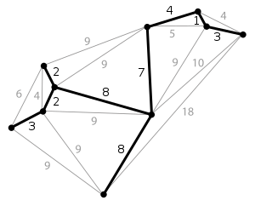
KRUSKAL’S ALGORITHM
Minimum Spanning Tree
A minimum spanning tree (MST) or minimum weight spanning tree is a subset of the edges of a connected, edge-weighted undirected graph that connects all the vertices together, without any cycles and with the minimum possible total edge weight
A minimum spanning tree has (V – 1) edges where V is the number of vertices in the given graph.

Slide 5
KRUSKAL’S ALGORITHM
Algorithm to find MST
Sort all the edges in non-decreasing order of their weight.
Pick the smallest edge. Check if it forms a cycle with the spanning tree formed so far.
If cycle is not formed, include this edge.
Else discard it.
Repeat step-2 until there are (V-1) edges in the spanning tree.
Note: Step #2 uses the Union-Find algorithm to detect cycles.

Slide 6
KRUSKAL’S ALGORITHM
Algorithm to find MST
Sort all the edges in non-decreasing order of their weight.
Pick the smallest edge. Check if it forms a cycle with the spanning tree formed so far.
If cycle is not formed, include this edge.
Else discard it.
Repeat step-2 until there are (V-1) edges in the spanning tree.
Note: Step 2 uses the Union-Find algorithm to detect cycles.

Slide 7
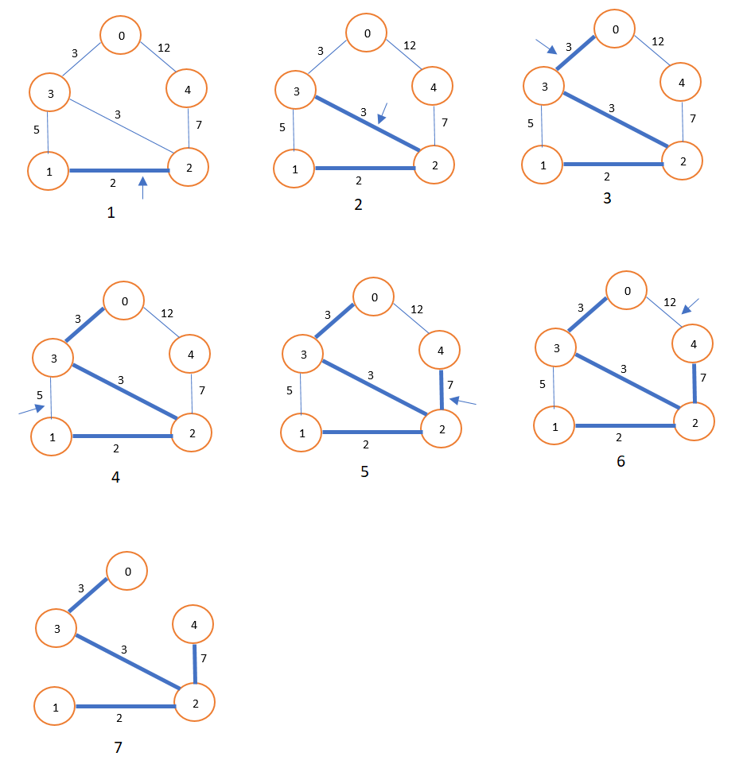
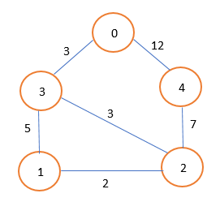
Algorithm in Action

Slide 8
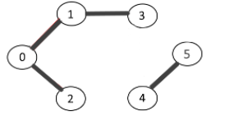
KRUSKAL’S ALGORITHM
Program
disjset1.java
Sample IO
Input
Output
Set Id: 0 elements: [0, 1, 2, 3]
Set Id: 4 elements: [4, 5]
Explanation:
The Graph is input to the program and it provides a disjoint set output

Slide 9
UNION-FIND AND DISJOINT-SET
Disjoint-Set data structure
A disjoint-set data structure that keeps track of a set of elements partitioned into a number of disjoint or non-overlapping subsets.
It provides near-constant-time operations to add new sets, to merge existing sets, and to determine whether elements are in the same set.
Plays a key role in Kruskal’s algorithm for finding the minimum spanning tree of a graph.
This can also be used to detect cycle in the graph.

Slide 10
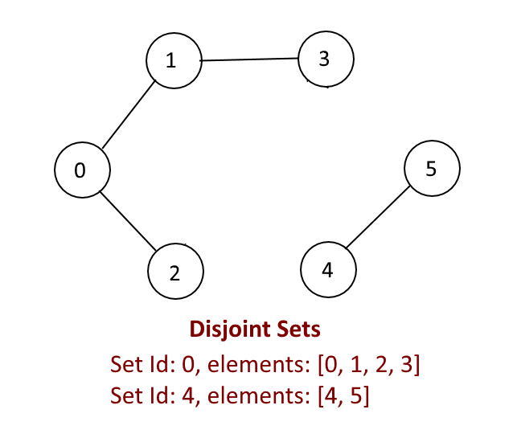
KRUSKAL’S ALGORITHM
Disjoint-Set Construction
A disjoint-set forest consists of a number of elements each of which stores an id, a parent pointer
The parent pointers of elements are arranged to form one or more trees, each representing a set.
If an element’s parent pointer points to no other element, then the element is the root of a tree and is the representative member of its set.
A set may consist of only a single element. However, if the element has a parent, the element is part of whatever set is identified by following the chain of parents upwards until a representative element (one without a parent) is reached at the root of the tree.

Slide 11
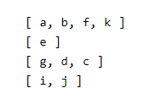
KRUSKAL’S ALGORITHM
Disjoint-Set Operations
The sets shown at the right are disjoint because they have no members in common.
Union-Find supports three basic operations:
Find(A): Determine which subset an element A is in. For example, find(d) would return the subset [ g, d, c ].
Union(A, B): Join two subsets that contain A and B into a single subset. For example, union(d, j) would combine [ g, d, c ] and [ i, j ] into the larger set [ g, d, c, i, j ].
AddSet(A): Add a new subset containing just that element A. For example, addSet(h) would add a new set [ h ].

Slide 12
KRUSKAL’S ALGORITHM
Program
disjset1.java
Sample IO
Input
Output
Set Id: 0 elements: [0, 1, 2, 3]
Set Id: 4 elements: [4, 5]
Explanation:
The Graph is input to the program and it provides a disjoint set output

Slide 13
KRUSKAL’S ALGORITHM
import java.util.*; public class DisjointSet { static class Edge { int source; int destination; public Edge(int source, int destination) { this.source = source; this.destination = destination; } } static class Graph { int vertices; LinkedList < Edge > [] adjList; ArrayList < Edge > allEdges = new ArrayList < > (); Graph(int vertices) { this.vertices = vertices; adjList = new LinkedList[vertices]; for (int i = 0; i < vertices; i++) { adjList[i] = new LinkedList < > (); | }} public void addEgde(int source, int destination) { Edge edge = new Edge(source, destination); adjList[source].addFirst(edge); allEdges.add(edge); } public void makeSet(int[] parent) { for (int i = 0; i < vertices; i++) { parent[i] = i; } } public int find(int[] parent, int vertex) { if (parent[vertex] != vertex) return find(parent, parent[vertex]);; return vertex; }

Slide 14
KRUSKAL’S ALGORITHM
public void union(int[] parent, int x, int y) { int x_set_parent = find(parent, x); int y_set_parent = find(parent, y); parent[y_set_parent] = x_set_parent; } public void disjointSets() { int[] parent = new int[vertices]; makeSet(parent); for (int i = 0; i < allEdges.size(); i++) { Edge edge = allEdges.get(i); int x_set = find(parent, edge.source); int y_set = find(parent, edge.destination); if (x_set == y_set) { //do nothing } else union(parent, x_set, y_set); } printSets(parent); } | public void printSets(int[] parent) { HashMap < Integer, ArrayList < Integer >> map = new HashMap < > (); for (int i = 0; i < parent.length; i++) { if (map.containsKey(parent[i])) { ArrayList < Integer > list = map.get(parent[i]); list.add(i); map.put(parent[i], list); } else { ArrayList < Integer > list = new ArrayList < > (); list.add(i); map.put(parent[i], list); } }

Slide 15
UNION-FIND AND DISJOINT-SET
//Print the Different sets Set < Integer > set = map.keySet(); Iterator < Integer > iterator = set.iterator(); while (iterator.hasNext()) { int key = iterator.next(); System.out.println("Set Id: " + key + " elements: " + map.get(key)); } } } public static void main(String[] args) { int vertices = 6; Graph graph = new Graph(vertices); graph.addEgde(0, 1); graph.addEgde(0, 2); graph.addEgde(1, 3); graph.addEgde(4, 5); graph.disjointSets(); } }

Slide 16
Question: 01
KRUSKAL’S ALGORITHM
Question: 01
Disjoint-Set data structure
A disjoint-set data structure that keeps track of a set of elements partitioned into a number of disjoint or non-overlapping subsets.
It provides near-constant-time operations to add new sets, to merge existing sets, and to determine whether elements are in the same set.
Plays a key role in Kruskal’s algorithm for finding the minimum spanning tree of a graph.
This can also be used to detect cycle in the graph.

Slide 17
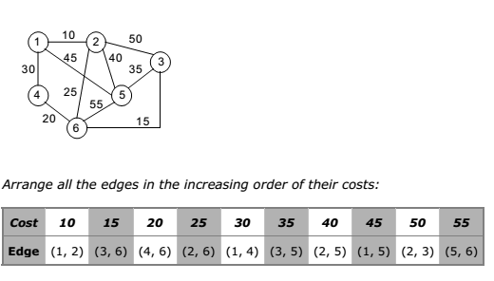
Question: 01
KRUSKAL’S ALGORITHM
Question: 01
Algorithm in Action: Another Example

Slide 18
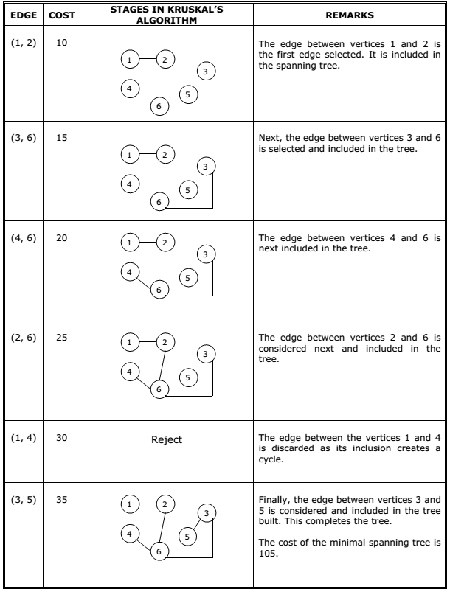
KRUSKAL’S ALGORITHM
Question: 01
Question: 01

Slide 19
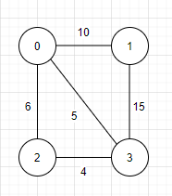
Question: 01
KRUSKAL’S ALGORITHM
Question: 01
Program
kruskal1.java
Sample IO
Input
Output
Following are the edges in the constructed MST
2 -- 3 == 4
0 -- 3 == 5
0 -- 1 == 10
Minimum Cost Spanning Tree: 19
Time Complexity
O(ELogE)

Slide 20
Question: 01
KRUSKAL’S ALGORITHM
Question: 01
import java.util.*; import java.lang.*; import java.io.*; class Graph { class Edge implements Comparable<Edge> { int src, dest, weight; public int compareTo(Edge compareEdge) { return this.weight - compareEdge.weight; }}; class subset { int parent, rank; }; int V, E; Edge edge[]; Graph(int v, int e) | { V = v; E = e; edge = new Edge[E]; for (int i = 0; i < e; ++i) edge[i] = new Edge(); } for (int i = 0; i < e; ++i) edge[i] = new Edge(); } int find(subset subsets[], int i) { if (subsets[i].parent != i) subsets[i].parent= find(subsets, subsets[i].parent); return subsets[i].parent; } void Union(subset subsets[], int x, int y) { int xroot = find(subsets, x); int yroot = find(subsets,Y);

Slide 21
Question: 01
KRUSKAL’S ALGORITHM
Question: 01
if (subsets[xroot].rank
< subsets[yroot].rank)
subsets[xroot].parent = yroot;
else if (subsets[xroot].rank
> subsets[yroot].rank)
subsets[yroot].parent = xroot;
else {
subsets[yroot].parent = xroot;
subsets[xroot].rank++;
}
}

Slide 22
Question: 01
KRUSKAL’S ALGORITHM
Question: 01
void KruskalMST()
{
Edge result[] = new Edge[V];
int e = 0;
int i = 0;
for (i = 0; i < V; ++i)
result[i] = new Edge();
Arrays.sort(edge);
subset subsets[] = new subset[V];
for (i = 0; i < V; ++i)
subsets[i] = new subset();
for (int v = 0; v < V; ++v)
{
subsets[v].parent = v;
subsets[v].rank = 0;
}
i = 0;
while (e < V - 1)
{
Edge next_edge = edge[i++];
int x = find(subsets, next_edge.src);
int y = find(subsets, next_edge.dest);
if (x != y) {
result[e++] = next_edge;
Union(subsets, x, y);
}}

Slide 23
Question: 01
KRUSKAL’S ALGORITHM
Question: 01
System.out.println("Following are the edges in the constructed MST");
int minimumCost = 0;
for (i = 0; i < e; ++i)
{
System.out.println(result[i].src + " -- "
+ result[i].dest + " == " + result[i].weight);
minimumCost += result[i].weight;
}
System.out.println("Minimum Cost Spanning Tree "
+minimumCost);
}

Slide 24
Question: 01
KRUSKAL’S ALGORITHM
public static void main(String[] args) { int V = 4; int E = 5; Graph graph = new Graph(V, E); graph.edge[0].src = 0; graph.edge[0].dest = 1; graph.edge[0].weight = 10; graph.edge[1].src = 0; graph.edge[1].dest = 2; graph.edge[1].weight = 6; graph.edge[2].src = 0; graph.edge[2].dest = 3; graph.edge[2].weight = 5; | graph.edge[3].src = 1; graph.edge[3].dest = 3; graph.edge[3].weight = 15; graph.edge[4].src = 2; graph.edge[4].dest = 3; graph.edge[4].weight = 4; graph.KruskalMST(); } }

Slide 25




THANK YOU
+91 78150 95095
codemithra@ethnus.com
www.codemithra.com

